Slide 1

CSCI E-25 Computer Vision
Introduction to Computer Vision
Steve Elston
Copyright 2022, 2023, 2024, 2025, 2026, Stephen F Elston. All rights reserved.

Slide 2
What is Computer Vision?
Computer vision enables computers to perform tasks with images
Image enhancement, filtering, and projection
Object detection
Object identification
Scene interpretation and labeling
Image segmentation
3D depth estimation
Image generation
Similarity search
..….

Slide 3
What is Computer Vision?
Computer vision is a dynamic and fast-moving area of AI
With recent technical advances tasks that were impossible or impractical 10 years ago are performed routinely
Impact of deep learning
Methods and algorithms advancing rapidly
Landmark paper, Krizhevsky et.al., 2012, sparked the current era of deep learning in CV
With rapidly growing capability the number of applications is exploding
New ideas appear constantly
Economics of CV has improved rapidly
Low power system on a chip
IOT deployments

Slide 4
What is Computer Vision?
Many applications of computer vision
Industrial inspection
Robotics and autonomous vehicles
Scientific analysis – e.g. remote sensing, seismology, astrophysics, etc.
Medical image interpretation
Sporting event tracking
Wildlife monitoring
Security
Image search
…..

Slide 5
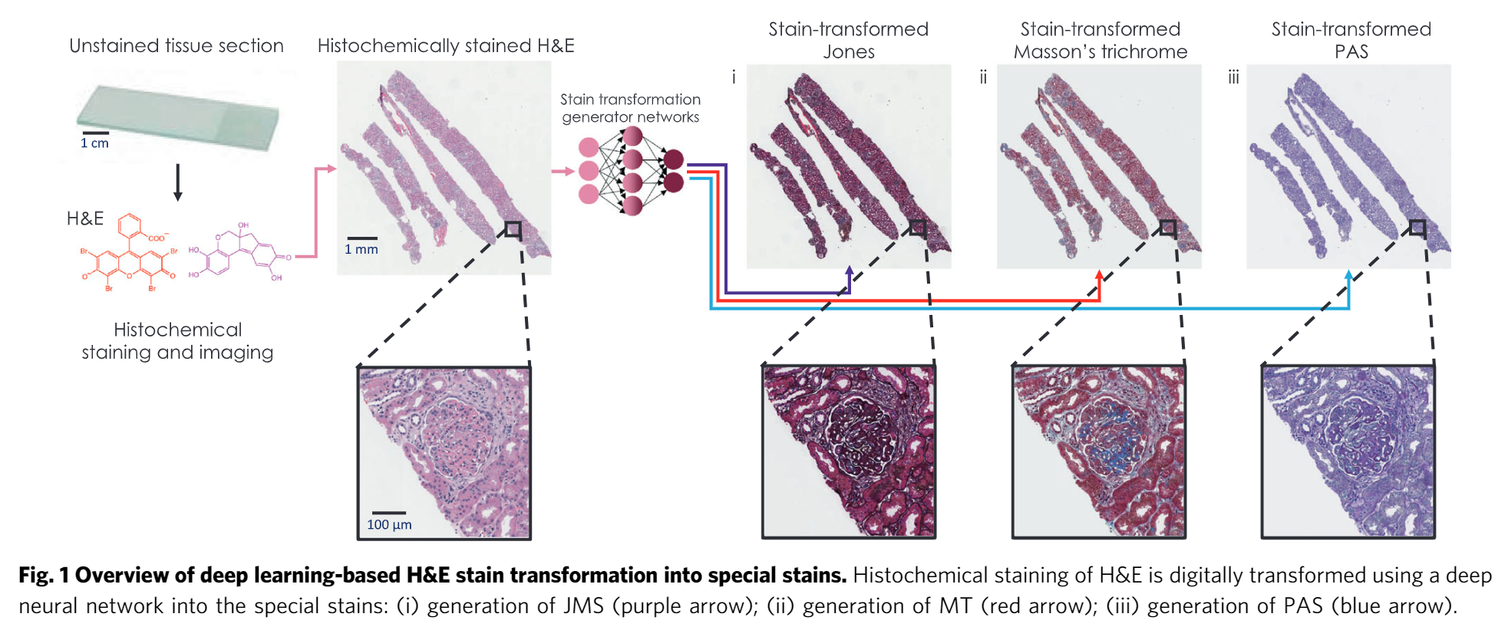
Medical Application of Computer Vision
Learning to virtually stain histological samples to simplify pathology diagnoses
Hnna, et. al., Deep learning-based transformation of H&E stained tissues into special stains, Nature Communications, 2021.

Slide 6
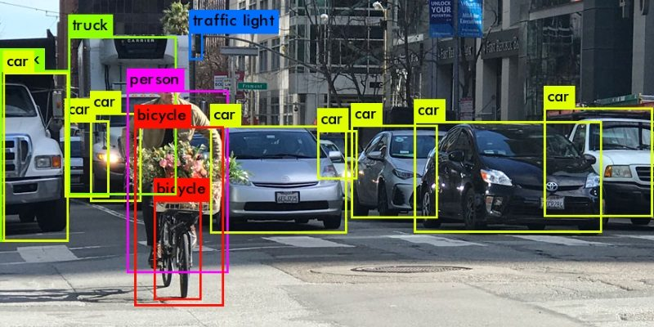
Autonomous Vehicle CV Application
Learning to track and identify moving objects in the environment
https://heartbeat.comet.ml/introduction-to-basic-object-detection-algorithms-b77295a95a63

Slide 7
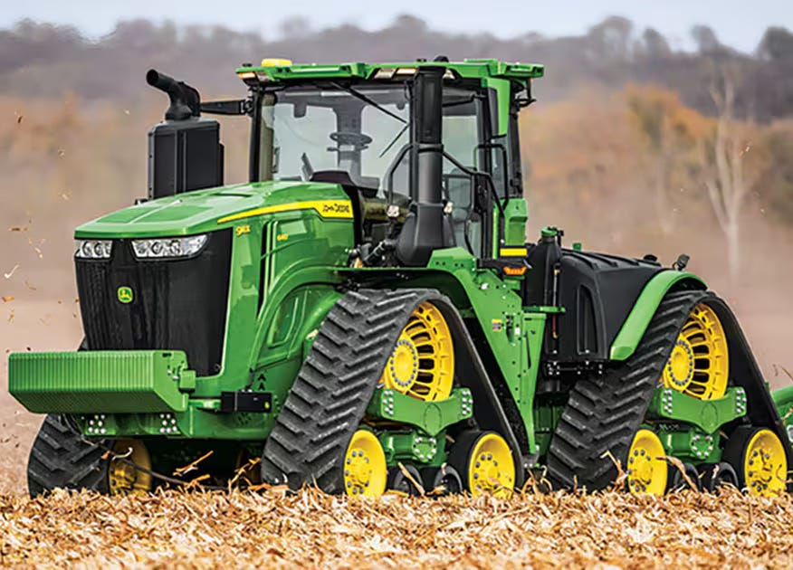
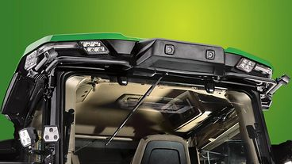
CV in Agriculture
Stereo camera pairs surround cab
Picture Credit, John Deere & Company.
Autonomous tractor uses CV and GPS for navigation and safety
See demonstration video here and discussion of CV and other AI used here

Slide 8
About This Couse

Slide 9
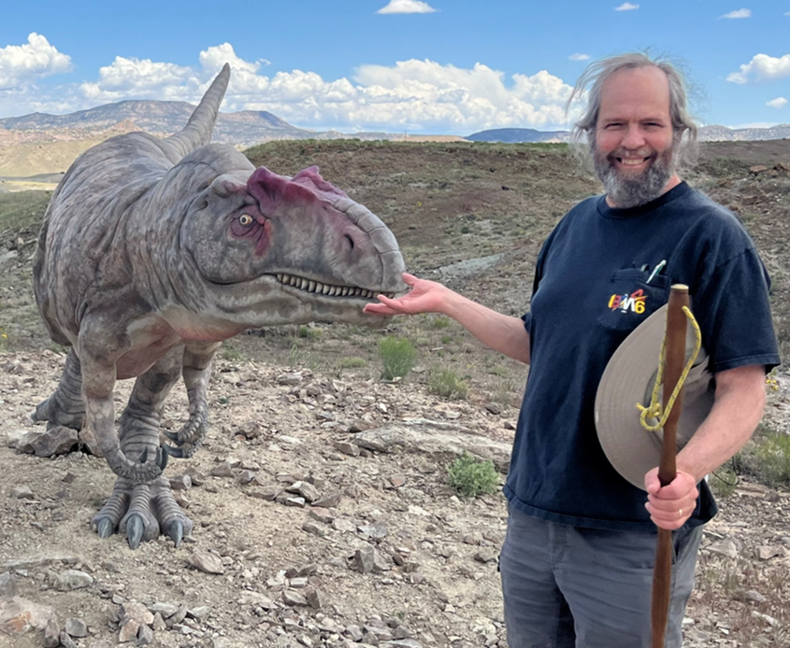
About your Instructor: Steve Elston
Instructor for Harvard since 2017
Data science consultant with several decades of experience
Lead team that commercialized Bell Labs S, now opensource R
Company co-founder and held executive positions in several industries
Creator of multiple edX courses, author of books and articles
Inventor on 5 patents
BS, physics and math (minor), University of New Mexico
MS and PhD, geophysics, Princeton University – John von Neuman Supercomputing Fellow
I love anything to do with natural history and the outdoors

Slide 10
Teaching Assistant: Tatyana Boland
5 years as Harvard TA
Education:
MBA in Finance from Texas A&M
MLA from Harvard Extension School in Sustainability & Environmental Management
BA in Political Science from University of Washington
Work Experience:
Current: Principle Technical Program Manage at Walmart, building automation for the global payroll
Previous: Worked at Nvidia as Sr TPM building cloud products, Oracle OCI as Principle TPM in Physical Networking team
I love playing the piano and playing and with my cats

Slide 11
About your TA: Jacqueline Hardy
Bachelor of Liberal Arts from Harvard Extension School, Major: International Relations, Minors: Government, Statistics – March 2018
Master of Liberal Arts from Harvard Extension School in Data Science – May 2024
7 years in Consumer Electronics (LG Electronics & SharkNinja)
Data Science & AI Compliance Consultant (JH DataStudio)
TA at Harvard Extension School – 2025, 2026
Love traveling with my bestie ☺ and aerial acrobatics

Slide 12
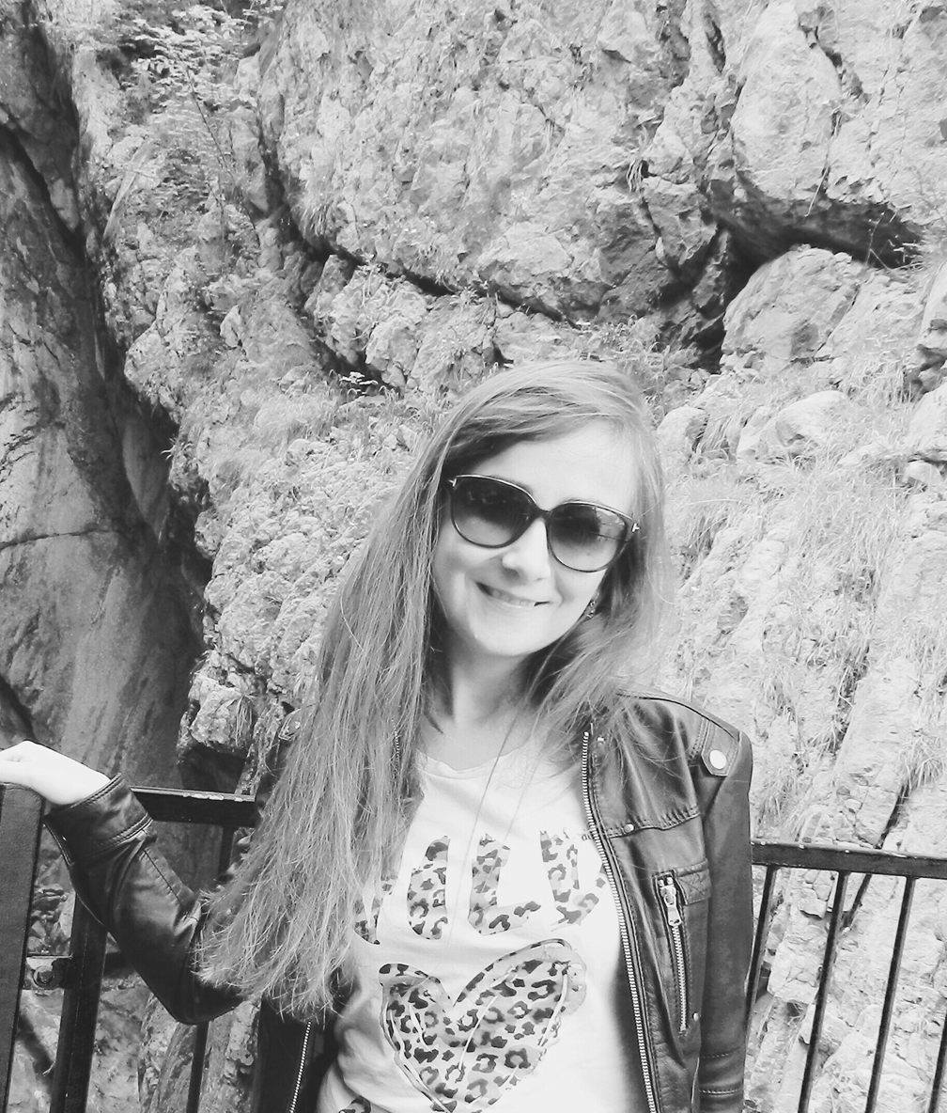
Teaching Assistant: Melahat Tayli
Academic foundation in Chemistry (BSc, MSc)
PhD in Polymer Engineering & Science
Transitioned into Data Science; completing ALM in Data Science at Harvard Extension School (Feb 2026)
6 years of research experience in academia & industry
Enjoys creating supportive, engaging, and student-centered learning environments

Slide 13
About this course
We will survey the fast moving and exciting subject of computer vision
Computer vision is a vast subject with a long history
Large and growing list of tasks
Many possible algorithms for each task
Computer vision has changed radically in the past 10 years
Deep learning continues to radically change the theory and practice of CV
As CV capabilities improve new algorithms and applications emerge constantly
Generative models are now having a significant impact on many tasks

Slide 14
About this Course
Focus on fundamental concepts rather than the very latest applications
We are time limited to one semester
Focus on building your broad foundation of theory and practical understanding of fundamentals
Building on this foundation you can explore rapidly changing algorithms and applications during your career
Hands-on exercises must adhere to limits of computational capacity and your time
Work with smaller datasets
Limit complexity of algorithms
You will mostly likely need a Google Colab Pro (or Pro+) paid subscription for some assignments and graduate credit projects
We will explore some fun applications!

Slide 15
About this course
Understanding theory essential to successful use of computer vision
Without understanding theory one is just turning knobs on a black box and hoping for the best
Selection and proper application of best algorithms for a task requires understanding of theory
Goal is for you to gain working understanding of theory for algorithms you apply now and in the future
We will explore some state-of-the-art algorithms along the way
But this course is not a tour of the latest AI APIs

Slide 16
About this course
Organization of lessons
First 7 weeks basic building blocks of CV
Properties of images and filtering, Lessons 1, 2
Deep neural nets, MLP, CNN, transformers for CV, Lessons 3, 4, 5
Generative models, Lessons 6, 7
Specific CV tasks discussed in second part of course
Object detection and image segmentation, Lessons 8, 9
Projections, image stitching, 3D models and optical flow, Lesson 10, 11, 12, 13
Other topics TBD as time premits

Slide 17
About this course
Computer vision is a highly emperical subject
Learning to work with image data is a core skill for CV
Hands on application of CV is at the intersection of theory and coding
But there are often deviations from ideal behavior
Understanding theory is essential to understanding and resolving problems
Try many solutions and see what works best
Try lots of ideas, fail fast, keep what works!!
The assignments for this course help you build these skills

Slide 18
Where can you find the course materials?
Read and understand the Syllabus in Canvas!
Material specific to this course are in the Github repository
Slides
Notebooks
Data
Supplementary materials
Assignment due dates, submissions, and grading in Canvas
Class assignments
Graduate independent projects

Slide 19
Where can you find the course materials?
Recommended reading primarily from these texts:
Foundations of Computer Vision, Torralba, Isola and Freeman, MIT Press, 2024
Deep Learning for Vision Systems, Mohamed Elgendy, Manning, 2020
Available on Harvard Library reserve in Canvas
Why take the time to do the reading?
CV is a vast and complex subject
We only cover the very basics in limited class time
The new book by Torralba et.al. provides interesting perspectives and in-depth discussions by three leading researchers

Slide 20
Communication
Ed Discussion is the primary means of communication for this course
Use Ed for help with assignments and projects
It’s okay to post small amounts of code!
Post code and complete exception messages if you are dealing with an error
Graded online class discussions take place in Ed
Private communications regarding matters such as grades
Use private Ed messages for fastest repones
Or, use email – addresses in the welcome message
One-on-one meetings can be arranged
Do not use Canvas messages, unless you want a delayed response!

Slide 21
Late Assignment Policy
Timely release of assignment solutions is an important part of the learning process
This is a fast-moving survey course
Do not fall behind! With 12 assignments and a project, there is no time to “catch-up”!
Late assignment policy:
Up to one day late - no penalty
Up to 5 days late - less 20%
More than 5 days late - no credit
Make sure you turn in work on time!

Slide 22
The Nature of Images

Slide 23
Working with Digital Images
Key points for this lesson
The nature of image formation
Representations of digital image data
Sampling digital image data and the effects of aliasing
Basic digital image preprocessing

Slide 24
The Nature of Images
Images can come in many forms
Still images
Video
Volumetric – CAT, MRI, seismic,…
Multi-spectral – remote sensing, industrial, agriculture,…
Specialized – scientific imaging, e.g. electron microsope
RADAR, LIDAR – earth science, autonomous vehicles,…
Acoustic - medical, seismic,…
……

Slide 25
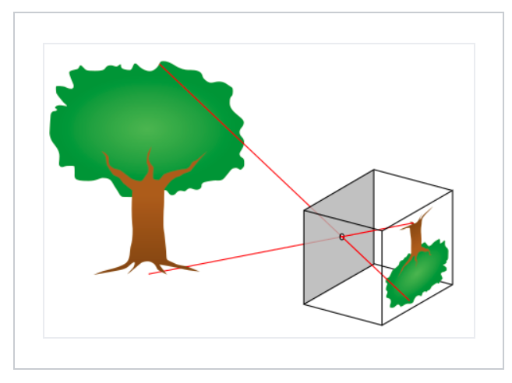
The Nature of Images
Basic image camera image formation
An optical camera forms an image from scattered light from an object
A pinhole camera or camera obscura forms an image by projecting light rays back to their source
Credit, Wikipedia commons

Slide 26
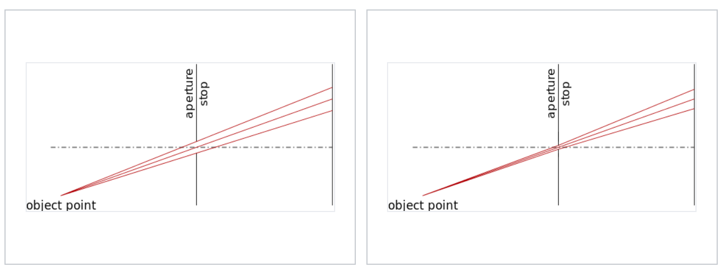
The Nature of Images
Basic image camera image formation
The smaller the aperture of the pinhole the better the focus to a point and the image is sharper, but less light passes
Aperture is parameterized by f-stops or f-number
Credit, Wikipedia commons

Slide 27
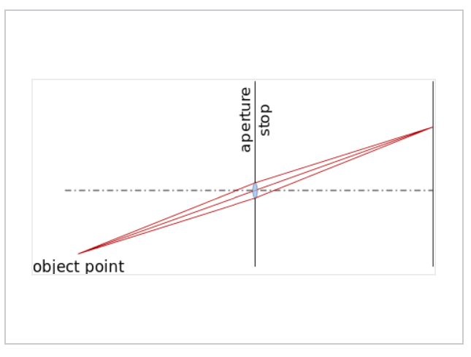
The Nature of Images
Basic image camera image formation
Adding a lens to the camera allows capturing more light with larger f-stop
Credit, Wikipedia commons

Slide 28
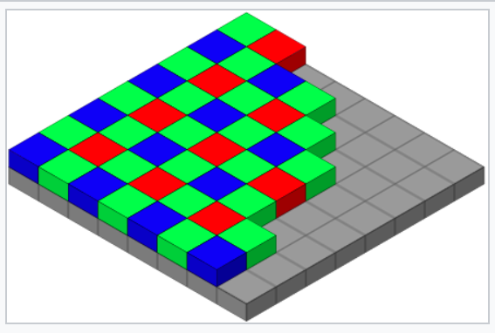
The Nature of Images
Basic image camera image formation
Digital cameras use a photo-sensitive device placed on the image plane
The Bayer-arrangement is an example of a photo-sensitive device arrangement that captures the red, green blue, primary colors into discrete pixels on the image plane
Photo-sensitive device on image plane
Credit, Wikipedia commons

Slide 29
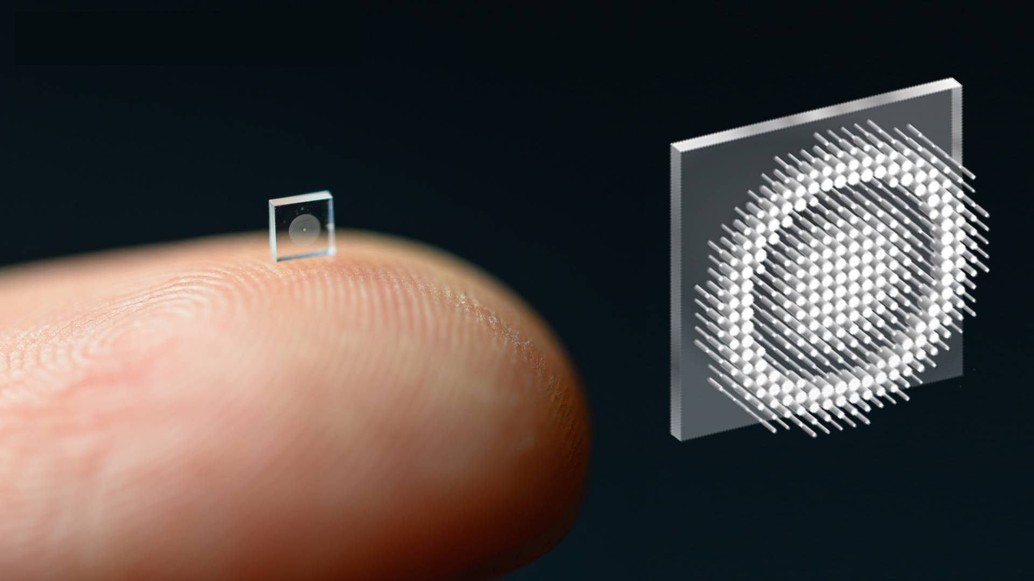
The Nature of Images
Future of imaging?
Nano technology cameras open new possibilities for CV
Camera focused using deep NN
Potential for micro applications and large imaging surfaces
Princeton University News, December 2, 2021

Slide 30
Representation of Digital Images

Slide 31
Working with Image Data
A grey scale image is represented as a two-dimensional tensor of pixel values
0 ,0
0 ,1
. . .
0 ,M-1
1 ,0
1 ,1
. . .
1 ,M-1
2 ,0
2 ,1
. . .
2 ,M-1
3 ,0
3 ,1
. . .
3 ,M-1
.
.
.
.
.
.
.
.
.
N-2 ,0
N-2 ,1
. . .
N-2 ,M-1
N-1,0
N-1,1
. . .
N-1,M-1
Unsigned integer pixel values have range {0,255}; black to white
Floating point pixel values in range {0,1}; black to white

Slide 32
Working with Multi-Spectral Data
Multi-spectral images are represented as 3-dimensional tensors
2 spatial dimensions
3rd dimension of frame are the color channels, or spectral bands
Ordinary color images have 3 channels – most usually red, green and blue
Spectrum of colors created by mixing primary colors with correct intensity
Scientific images can have many spectral channels
Example: multi-spectral remote sensing
Multi-spectral astrophysical images
3rd dimension can be depth (volume); e.g. medical and seismic images

Slide 33
Working with Image Data
A color image is a 3-dimensional tensor representing the three color channels
Mix (linear sum) primary RGB color channels to create spectrum of colors
Red
0 ,0,0
0 ,1,0
. . .
0 ,M-1,0
Green
1 ,0,0
1 ,1,0
. . .
1 ,M-1,0
0 ,0,0
0 ,1,0
. . .
0 ,M-1,1
Blue
2 ,0,0
2 1,0
. . .
2 ,M-1,0
1 ,0,0
1 ,1,0
. . .
1 ,M-1,1
0 ,M-1,2
3 ,0,0
3 ,1,0
. . .
3 ,M-1,0
2 ,0,0
2 1,0
. . .
2 ,M-1,1
1 ,M-1,2
.
.
.
.
.
.
.
.
.
. . .
3 ,0,0
3 ,1,0
3 ,M-1,1
2 ,M-1,2
.
.
.
.
.
.
.
.
.
3 ,M-1,2
N-2 ,0,0
N-2 ,1,0
. . .
N-2 ,M-1,0
.
.
.
N-1,0,0
N-1,1,0
. . .
N-1,M-1,0
N-2 ,0,0
N-2 ,1,0
. . .
N-2 ,M-1,1
N-1,0,1
N-1,1,1
. . .
N-2 ,0,0
N-2 ,1,0
N-1,M-1,1
N-2 ,M-1,2
N-1,0,2
N-1,1,2
. . .
N-1,M-1,2
Intensity of each color channel is on a scale of {0,255} or {0,1}

Slide 34
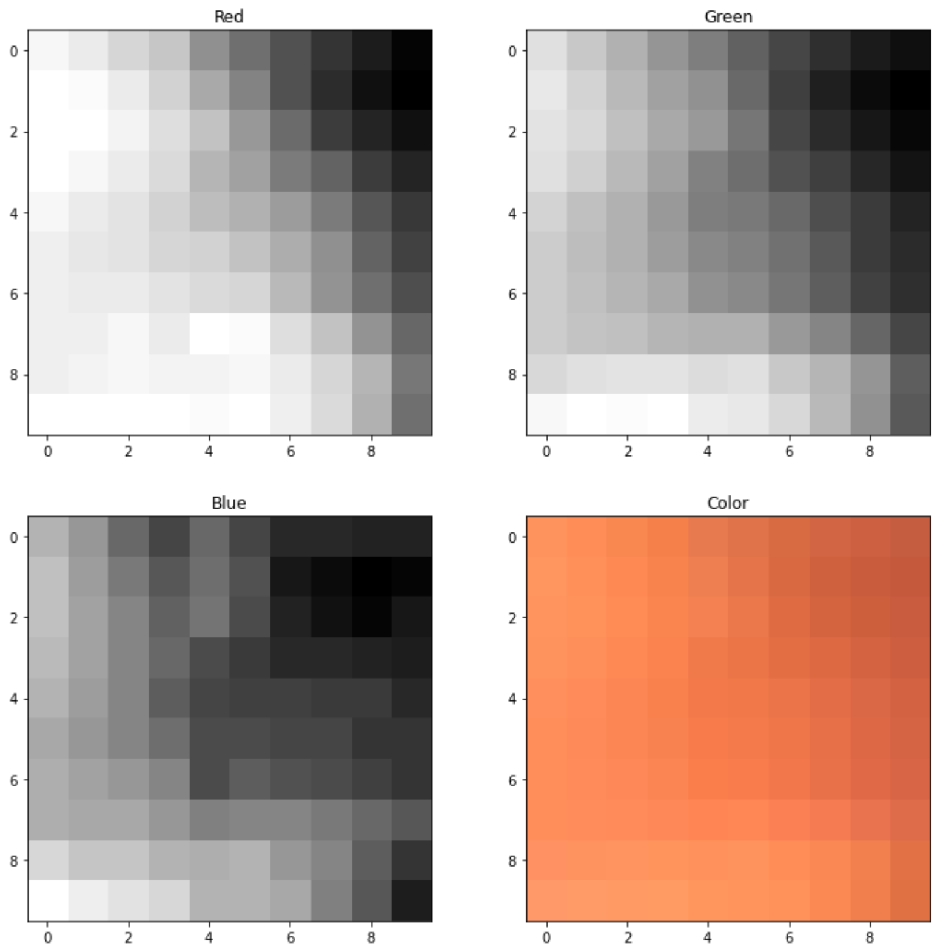
Working with Image Data
A color image is a 3-dimensional tensor representing the RGB color channels
Intensity of color is the pixel value in the channel on a scale of {0,255} or {0,1}
Mix (linear sum) primary color channels to create spectrum of colors

Slide 35
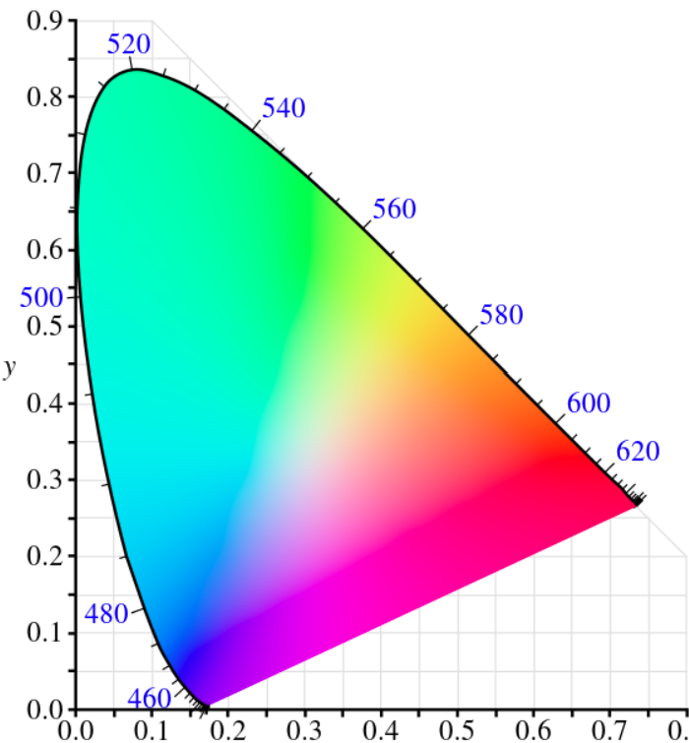
Working with Image Data
Many color schemes used in image representation
RGB is simple and most widely used
CIE 1931 (aka XYZ) uses wavelength (X, Y) and luminance (Z) to create a rich spectrum of color optimized for human vision
Can convert between schemes – e.g. skimage
But conversion may not be exact!
Credit, Wikipedia commons

Slide 36
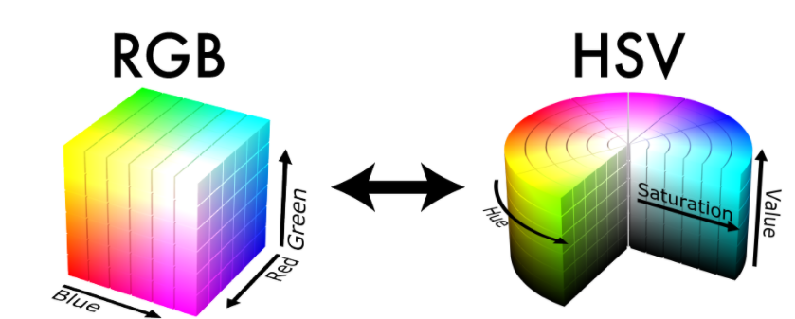
Working with Image Data
Many color schemes used in image representation
Hue, Saturation and Value (HSV) another alternative
Cylindrical coordinates with angle representing hue, radius representing saturation and vertical representing value
Can convert between schemes – e.g. skimage
But conversion may not be exact!
Credit, Wikipedia commons

Slide 37
Working with Image Data
Video is represented as a 4-dimensional tensor
2 spatial dimensions
3rd dimension for 3 color channels
4th dimension is the time sequence of images (frames)

Slide 38
Working with Image Data
0,0
Many machine learning algorithms use one data sample, as feature vector, at a time
1,0
.
.
.
0 ,0
0 ,1
. . .
0 ,M-1
1 ,0
1 ,1
. . .
1 ,M-1
N-2,0
For image data, we flatten the image to create feature vector:
. . .
N-1,0
2 ,0
2 ,1
2 ,M-1
Flatten
3 ,0
3 ,1
. . .
3 ,M-1
.
.
.
.
.
.
.
.
.
0,M-1
N-2 ,0
N-2 ,1
. . .
N-2 ,M-1
1,M-1
N-1,0
N-1,1
. . .
N-1,M-1
.
.
.
For multichannel images, flatten each channel and concatenate vectors
N-2,M-1
N-1,M-1

Slide 39
Image Preprocessing Overview

Slide 40
Preprocessing Images
Real-world CV pipelines invariably require image preprocessing
Performance of CV algorithms improved with proper preprocessing
Resizing
Up-sample
Down-sample
Anti-aliasing
Noise reduction filtering
Contrast enhancement and lighting adjustment
Histogram equalization
Logarithmic compression
Sigmodal adjustment
Edge enhancement, e.g. Hough transform

Slide 41
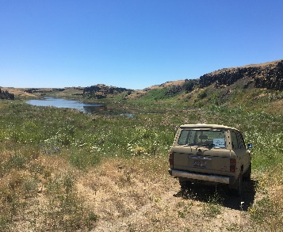
Preprocessing Images
Real-world computer vision pipelines require image preprocessing
Multiple preprocessing steps are typically applied before using an machine learning model
The ML model performance is never better than what image quality allows
Image Preprocessing
Size adjustment
Noise filtering
Contrast improvement
Color adjustment
…
Machine Learning
Inference
Input Image
Prepared Image

Slide 42
Sampling and Aliasing

Slide 43
Sampling and Aliasing
Digital images are spatially sampled into pixels
The value of the pixel represents the intensity of the illumination in the pixel area
Limit of spatial resolution is determined by the vertical and horizontal pixel sampling density
Limit of video temporal resolution is determined by frame rate
In volumetric imaging the samples are voxels – volumetric pixels
Example, medical MRI
Limit of resolution determined by voxel sampling density
Aliasing results if we try to sample an image with too low a pixel density

Slide 44
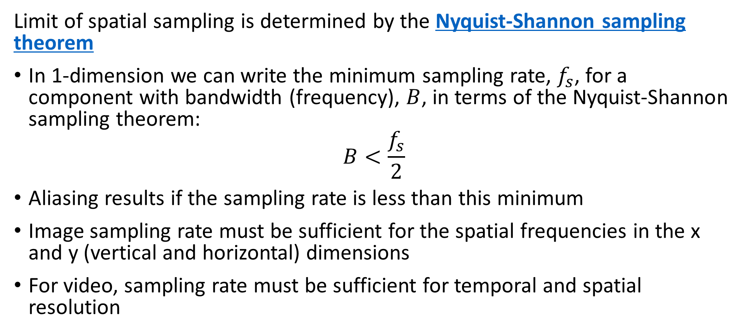
Sampling and Aliasing
Limit of spatial sampling is determined by the Nyquist-Shannon sampling theorem
In 1-dimension we can write the minimum sampling rate, $f_{s}$, for a component with bandwidth (frequency), $B$, in terms of the Nyquist-Shannon sampling theorem:
$$B<\frac{f_{s}}{2}$$
Aliasing results if the sampling rate is less than this minimum
Image sampling rate must be sufficient for the spatial frequencies in the x and y (vertical and horizontal) dimensions
For video, sampling rate must be sufficient for temporal and spatial resolution

Slide 45
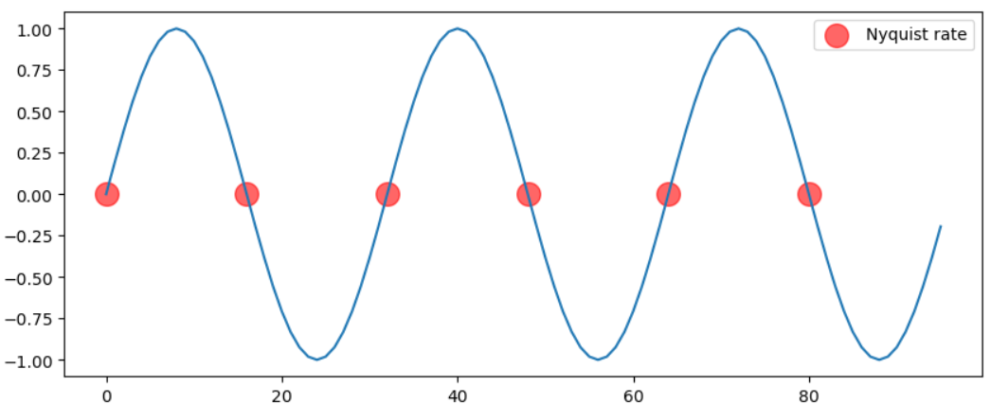
Sampling and Aliasing
Simple 1-D example of aliasing
Sine signal sampled at the Nyquist rate
2 samples per cycle aliases the signal
The samples all fall at the zero crossings – aliasing!

Slide 46
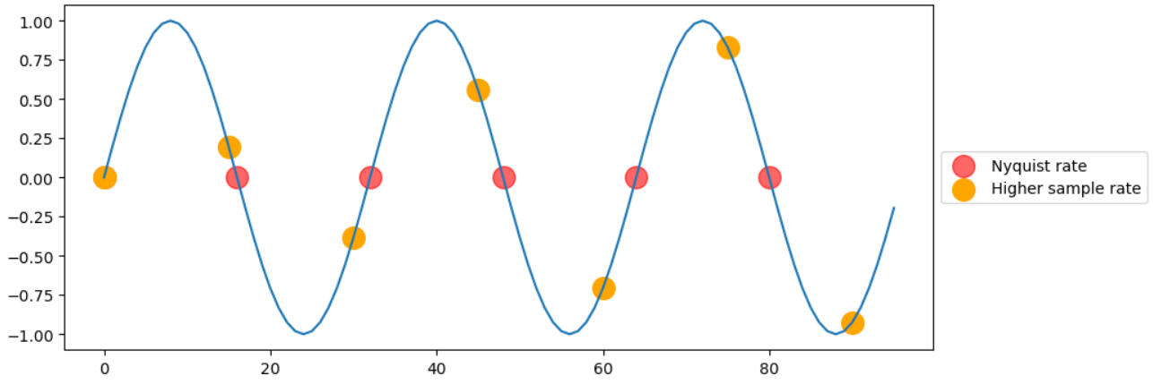
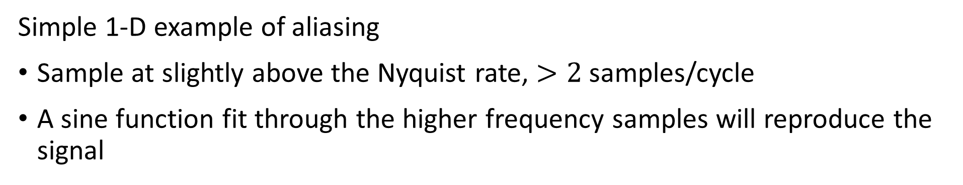
Sampling and Aliasing
Simple 1-D example of aliasing
Sample at slightly above the Nyquist rate, $>2$ samples/cycle
A sine function fit through the higher frequency samples will reproduce the signal

Slide 47
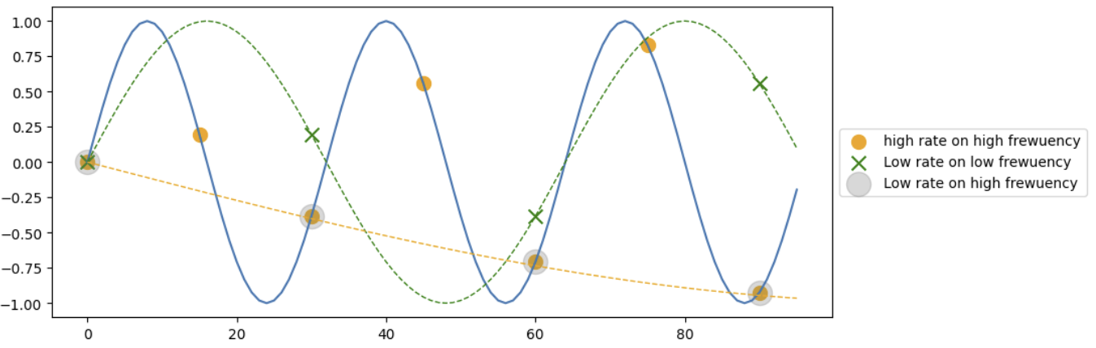
Sampling and Aliasing
Simple 1-D example of aliasing
Sample signal at ½ the frequency
Sample low frequency signal just above the Nyquist rate
The low-rate sample aliases the high frequency signal

Slide 48
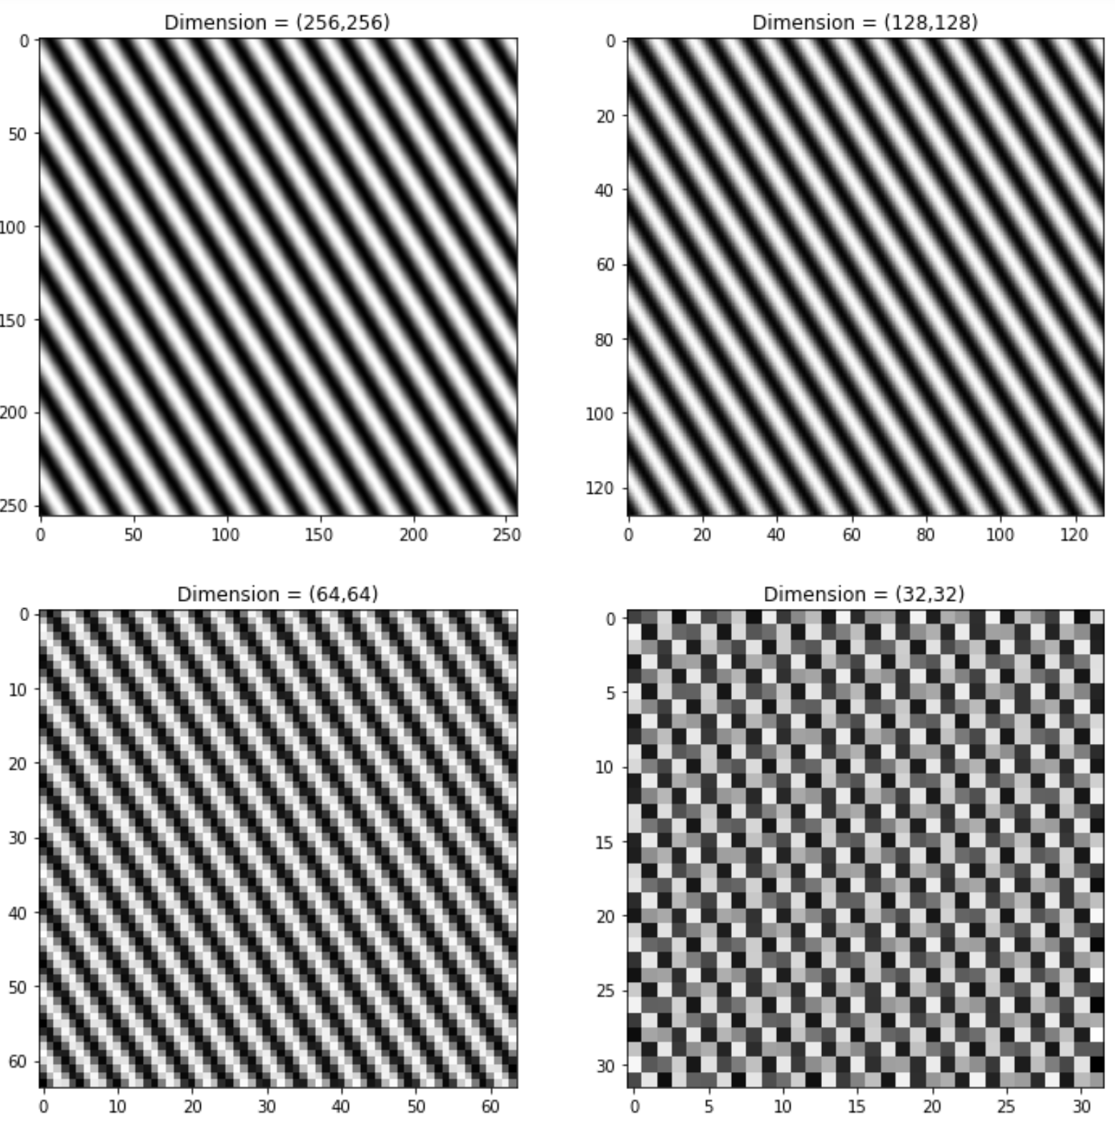
Sampling and Aliasing
Simple example of spatial aliasing
Sinusoidal signal in vertical and horizontal
Down sample the image by octaves until sampling frequency is less than Nyquist rate
The aliased image exhibits significant sampling artifacts!

Slide 49
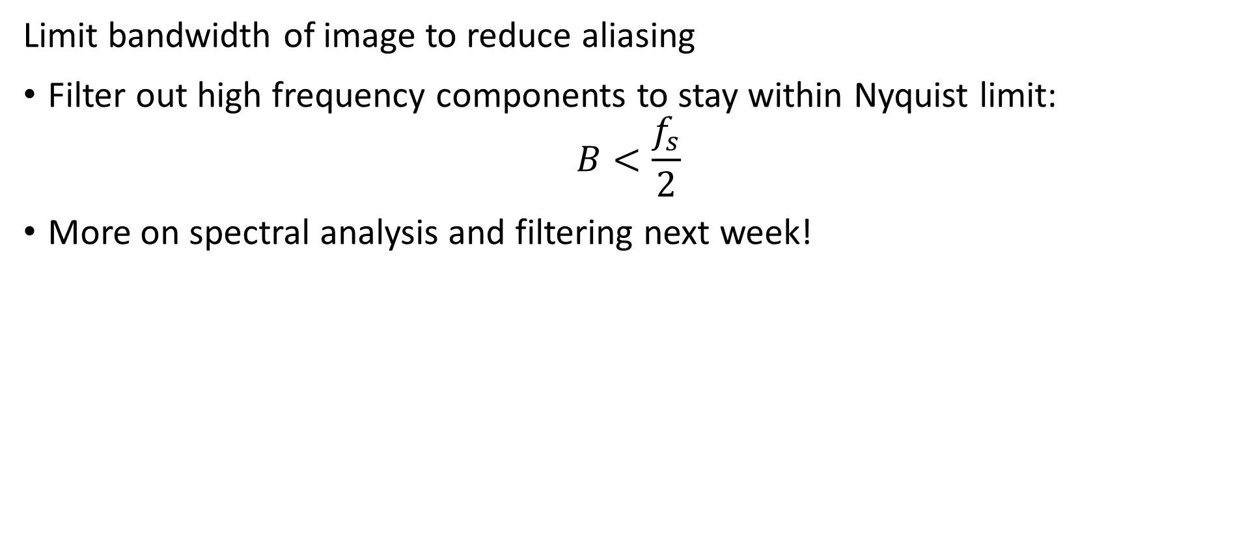
Sampling and Aliasing
Limit bandwidth of image to reduce aliasing
Filter out high frequency components to stay within Nyquist limit:
$$B<\frac{f_{s}}{2}$$
More on spectral analysis and filtering next week!

Slide 50
Preprocessing Image Basics
Resizing

Slide 51
Resizing Images
Resizing an image is a common pre-processing step in computer vision
Recall, pixel values represent the average illumination in a rectangular patch of the image area
Up sample – increase number of pixels
Down sample – reduce number of pixels
Use bilinear interpolation for pixel centre values
We investigate filter-based methods next week

Slide 52
Resizing Images
Resizing algorithms use interpolated values for pixel centres
For even factors of 2 resizing use mean interpolations
Use averages of adjacent pixel values
Arbitrary resizing can use spline interpolation or bilinear interpolation
Interpolate from original image pixel centre values to resized image pixel values
Many other interpolation methods are used
Gaussian convolutional filters
Convolutional neural networks
PCA/SVD and other generative models
More on these later

Slide 53
Preprocessing Image Basics
Contrast Improvement

Slide 54
Contrast and Illumination
Performance of computer vision algorithms can never be better than the input image
If the image features required for the task are not clear and well-defined, no algorithm can reliably perform the task
Common problems with images:
Poor illumination
Low contrast
Occluded features like edges

Slide 55
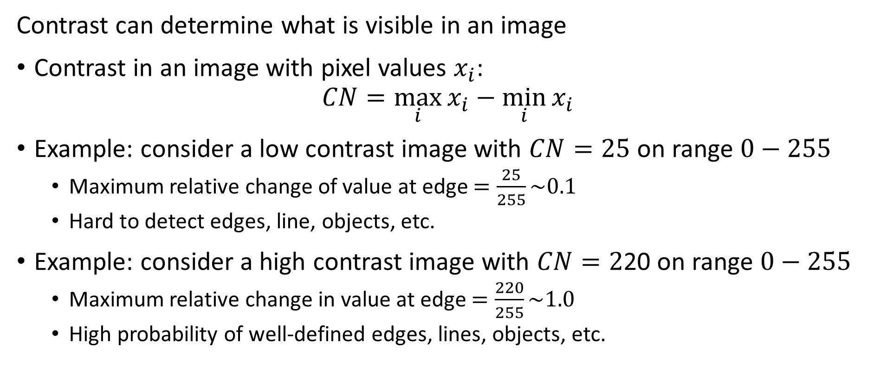
Contrast and Illumination
Contrast can determine what is visible in an image
Contrast in an image with pixel values $x_{i}$:
$$CN=\max_{i}{x_{i}−\min_{i}{x_{i}}}$$
Example: consider a low contrast image with $CN=25$ on range $0−255$
Maximum relative change of value at edge $=\frac{25}{255}\sim 0.1$
Hard to detect edges, line, objects, etc.
Example: consider a high contrast image with $CN=2$20 on range $0−255$
Maximum relative change in value at edge $=\frac{220}{255}\sim 1.0$
High probability of well-defined edges, lines, objects, etc.

Slide 56
Contrast Improvement
Contrast is the difference between the lightest and darkest components of a patch of an image
How can we improve the contrast of an image?
Find a transform to redistribute the pixel values
Ideally, want a uniform distribution of pixel values
Uniform distribution maximizes contrast

Slide 57
Contrast Improvement
Contrast improvement transformations
Many algorithms and methods for improving image contrast
Illumination control
Practical and widely used in scientific and industrial solutions
Commonly used algorithms include:
Histogram equalization, global and local
Gamma correction, pixel-wise
Logarithmic adjustment , pixel-wise
Sigmoidal adjustment , pixel-wise
Selection of methods dependent on situation
Notes:
ill

Slide 58
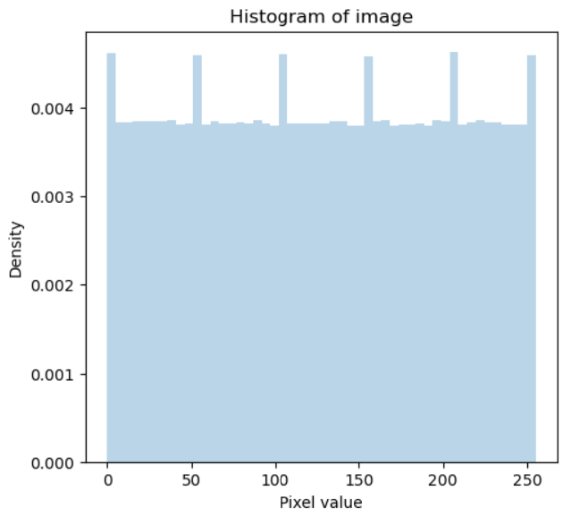
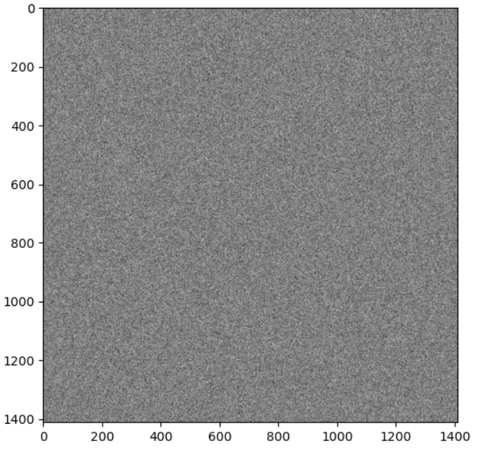
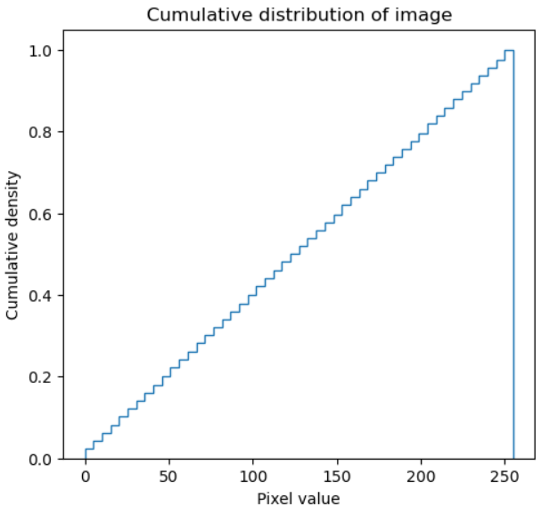
Contrast Improvement
Ideal distribution of pixel values resemble random image

Slide 59
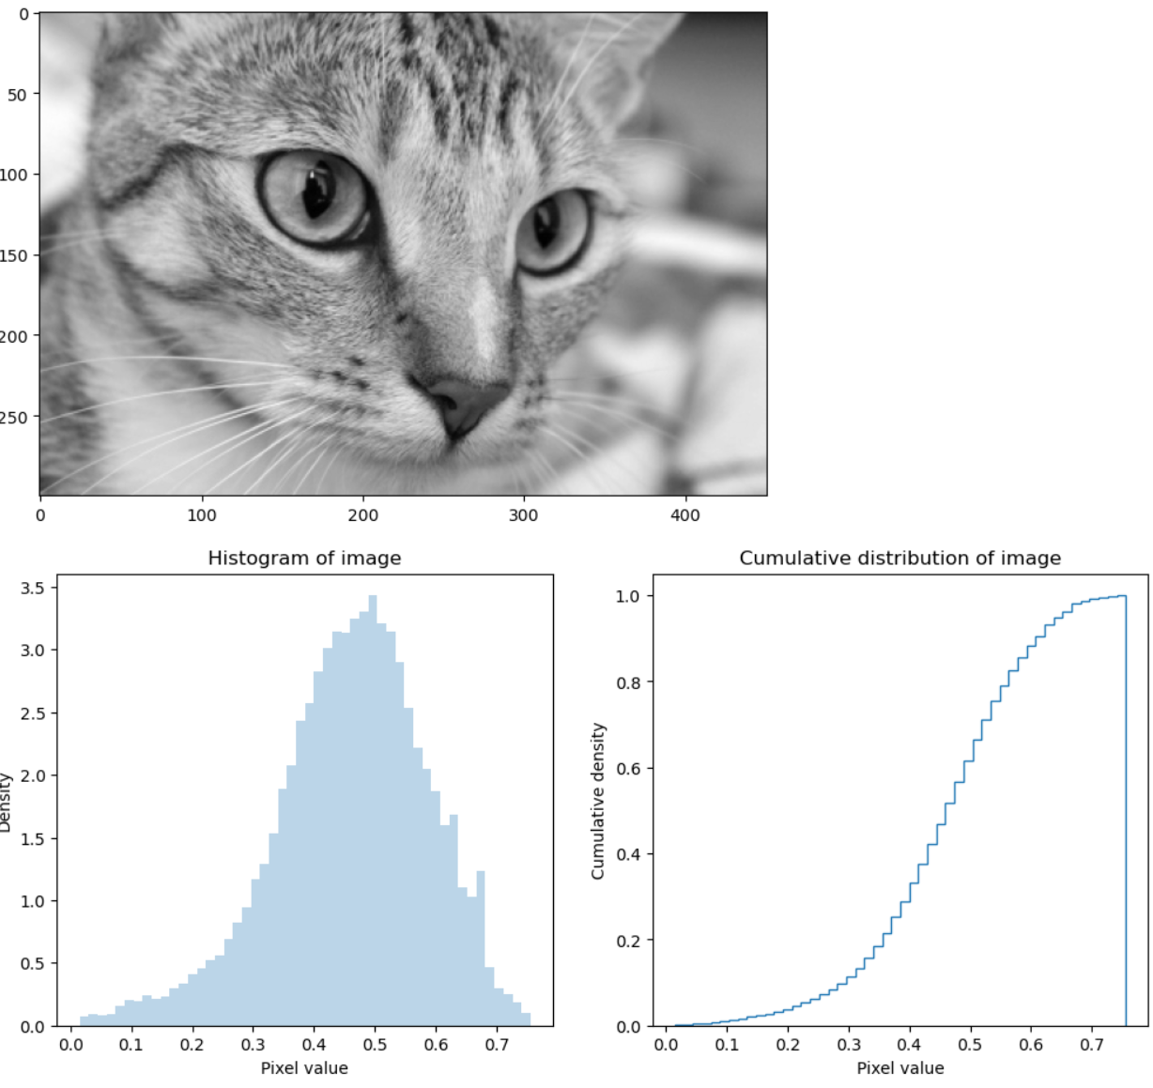
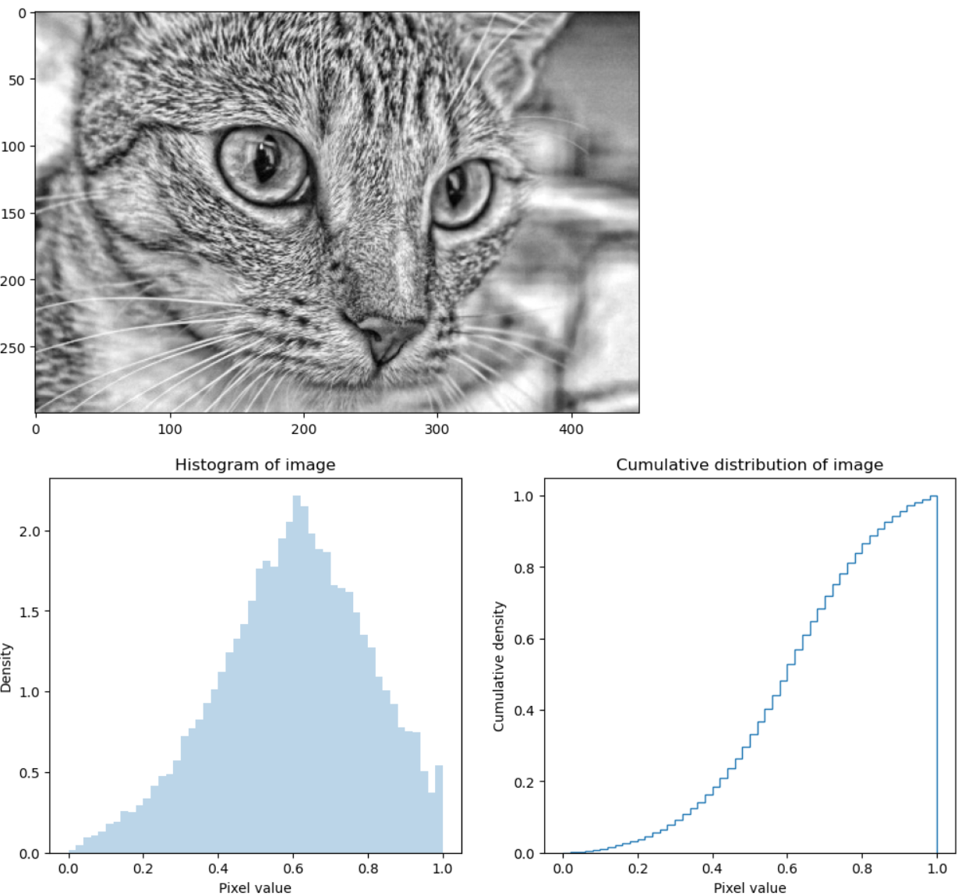
Contrast Improvement
Example of contrast limited adaptive histogram equalization for contrast improvement
Contrast Limited Adaptive histogram Equalization

Slide 60
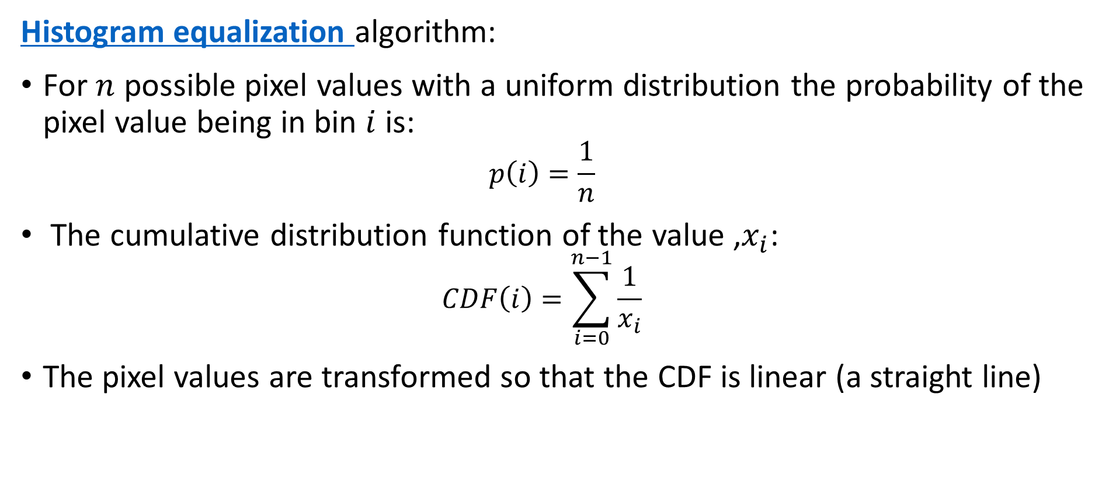
Contrast Improvement
Histogram equalization algorithm:
For $n$ possible pixel values with a uniform distribution the probability of the pixel value being in bin $i$ is:
$$p\left(i\right)=\frac{1}{n}$$
The cumulative distribution function of the value ,$x_{i}$:
$$CDF\left(i\right)=\sum_{i=0}^{n−1}{\frac{1}{x_{i}}}$$
The pixel values are transformed so that the CDF is linear (a straight line)

Slide 61
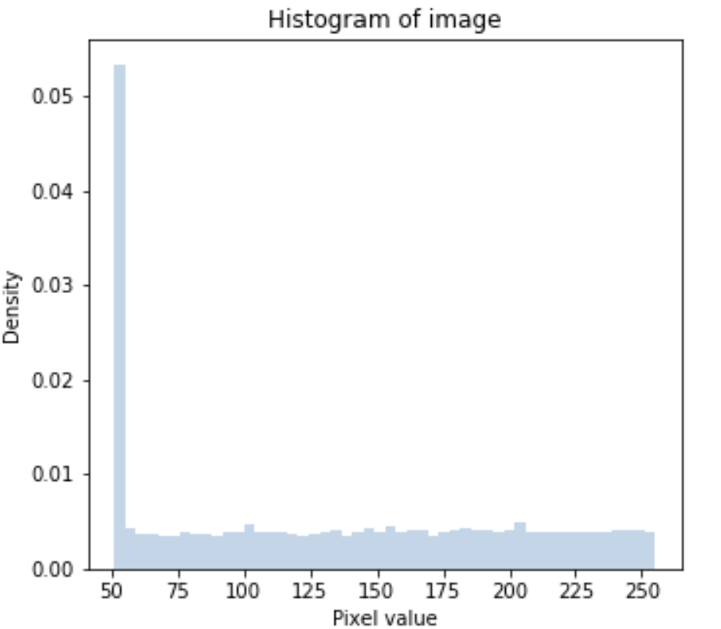
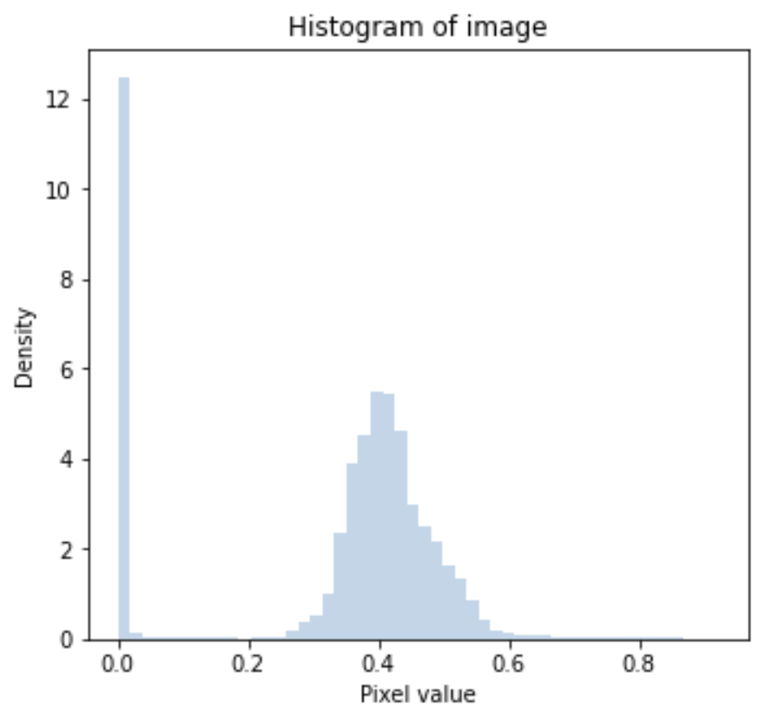
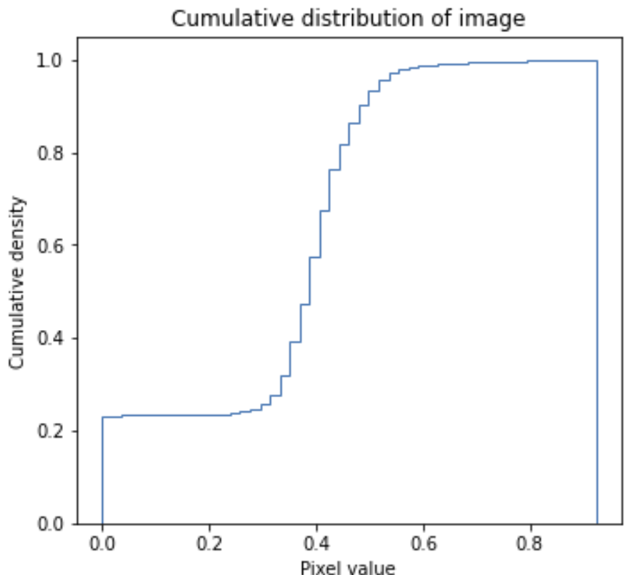
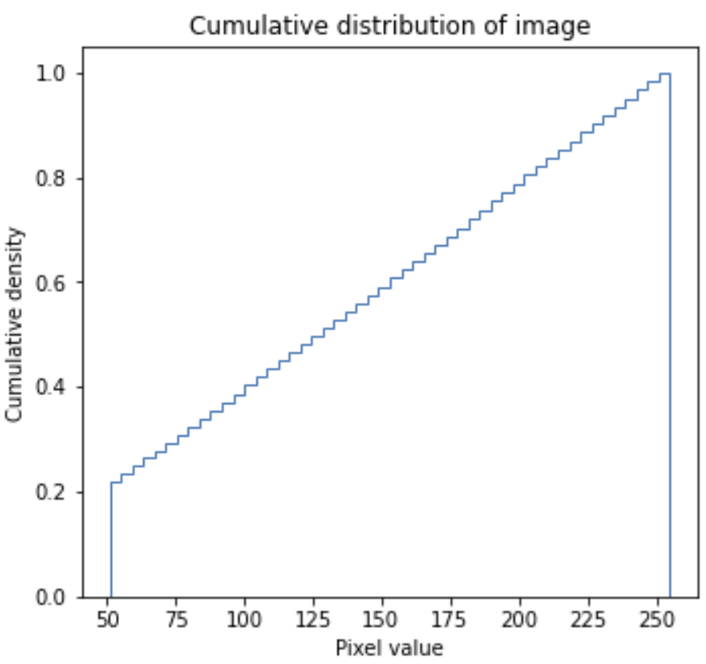
Contrast Improvement
Global histogram equalization
Transform pixel values to uniform distribution

Slide 62
Contrast Improvement
Standard histogram equalization algorithm assumes illumination distribution constant over the eentire image
But illumination and color vary across an image
Contrast improvement may not be optimal globally
Can optimized contrast locally
Locally adaptive histogram equalization
Improve contrast over local patches of the image
Adapts to local illumination and intensity

Slide 63
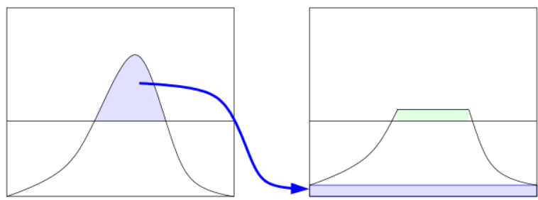
Contrast Improvement
Adaptive histogram equalization can over compensate in areas of similar intensity
Adaptive histogram equalization can amplify noise is areas with near constant illumination
Contrast limited adaptive histogram equalization (CLAHE) applies clipping to prevent over compensation
Clipped values are uniformly redistributed into the histogram
Redistributed values can push values above threshold
Several iterations may be required for convergence
Credit, Wikipedia commons

Slide 64
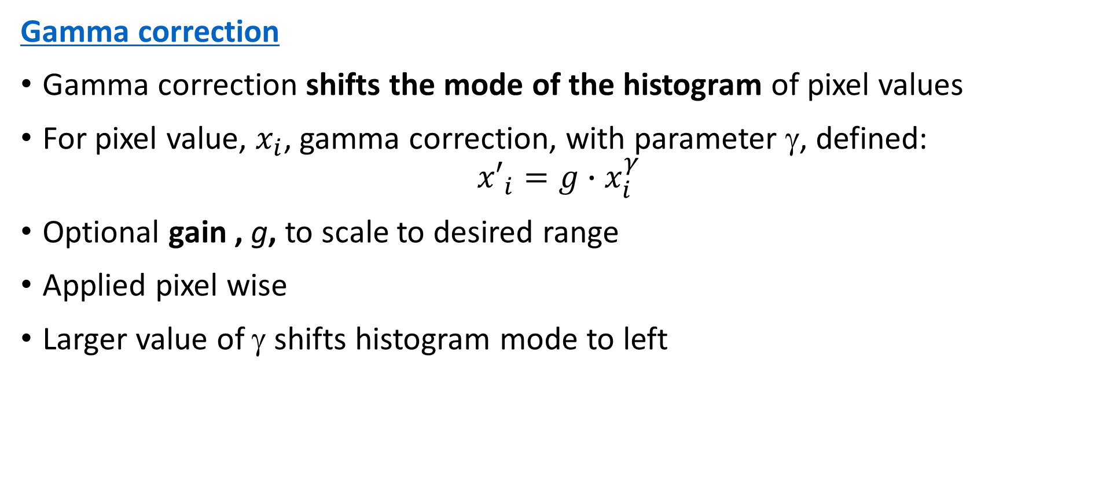
Contrast Improvement
Gamma correction
Gamma correction shifts the mode of the histogram of pixel values
For pixel value, $x_{i}$, gamma correction, with parameter γ, defined:
$${x′}_{i}=g{∙x}_{i}^{γ}$$
Optional gain , g, to scale to desired range
Applied pixel wise
Larger value of γ shifts histogram mode to left
Notes:
ill

Slide 65
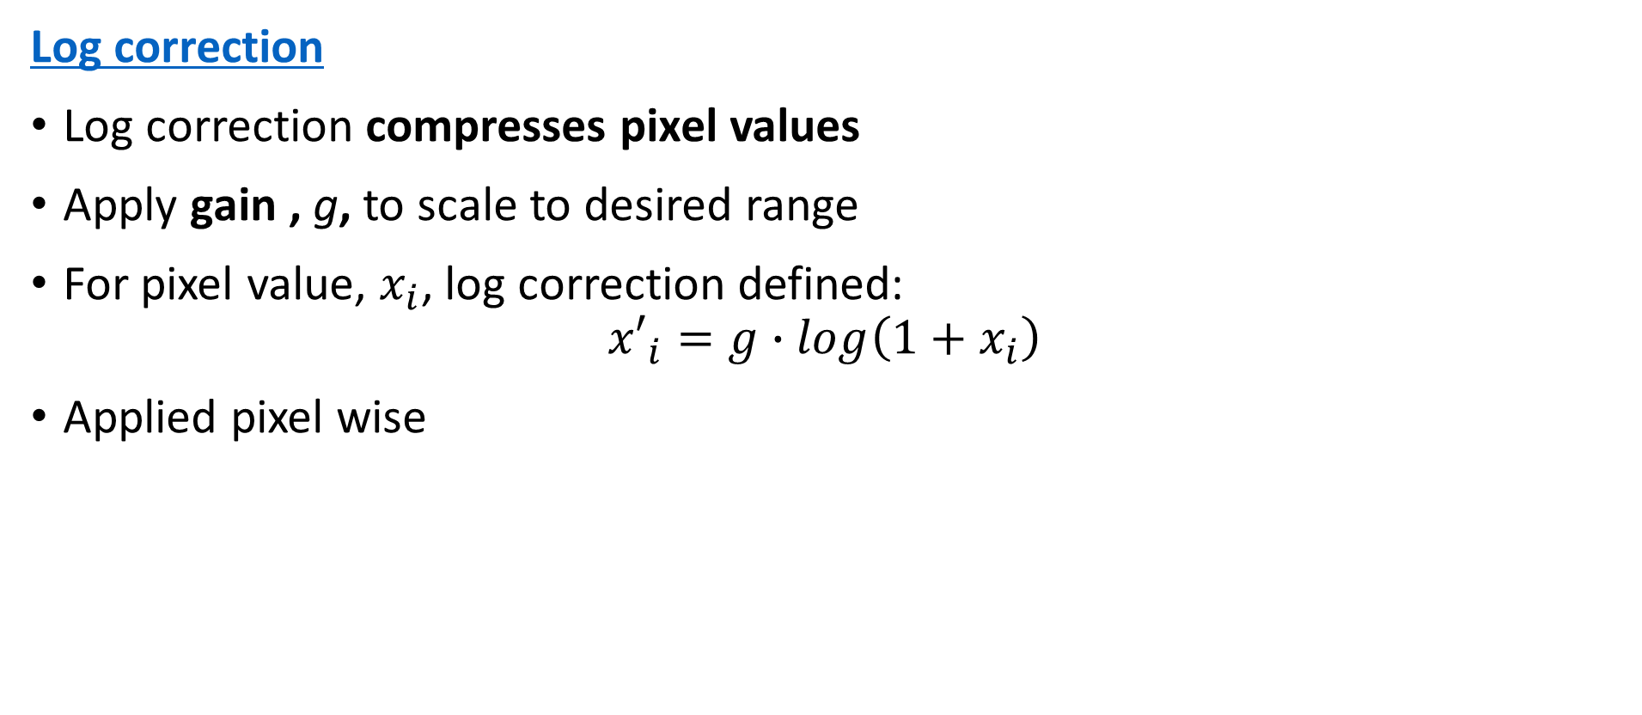
Contrast Improvement
Log correction
Log correction compresses pixel values
Apply gain , g, to scale to desired range
For pixel value, $x_{i}$, log correction defined:
$${x′}_{i}=g{∙log\left(1+x_{i}\right)}_{ }^{ }$$
Applied pixel wise
Notes:
ill

Slide 66
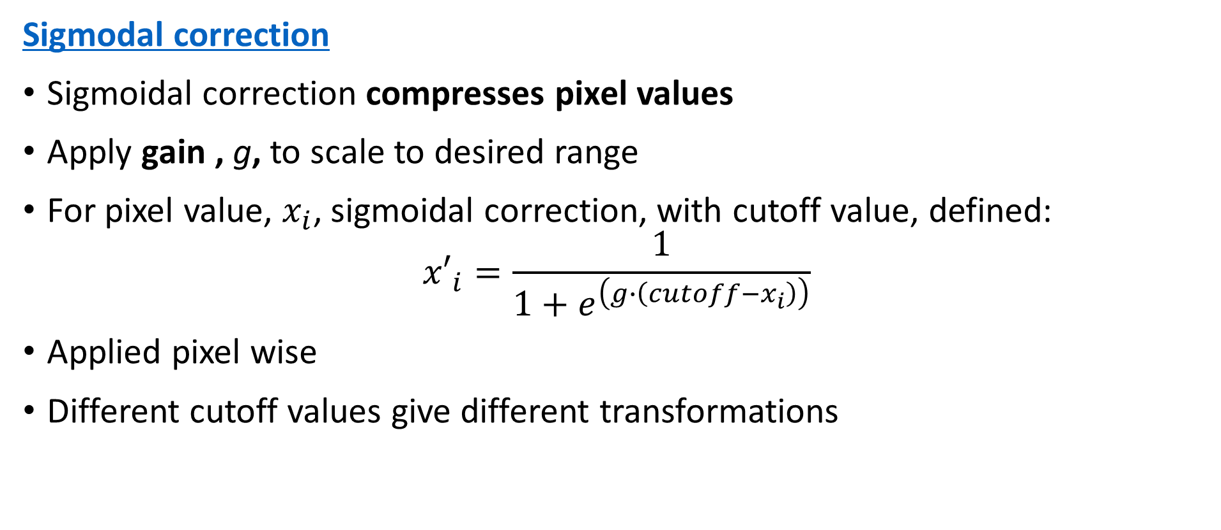
Contrast Improvement
Sigmodal correction
Sigmoidal correction compresses pixel values
Apply gain , g, to scale to desired range
For pixel value, $x_{i}$, sigmoidal correction, with cutoff value, defined:
$${x′}_{i}=\frac{1}{1+e^{\left(g∙\left(cutoff−x_{i}\right)\right)}}$$
Applied pixel wise
Different cutoff values give different transformations
Notes:
ill

Slide 67
Contrast Improvement
Color images require special treatment
Values in RGB color channels are not independent
Total intensity is sum of channel values
Transform to representation with explicit intensity
CIE 1931 (aka XYZ)
Hue, Saturation and Value (HSV)
…
Adjust contrast over intensity (value) of transformed image
Transform back to RGB format if needed

Slide 68
Summary
Key points for this lesson
The nature of image formation
Pinhole camera model
Several possible representations for digital images
Color and intensity
Digital image data sampling and aliasing effects
Sample rate must be above Shannon-Nyquist limit
Basic image preprocessing
Resize, filter, adjust the image

